Slide 1
Sporulation in the Expanding Firmicutes (Superphylum?)
Jordan Bird

Slide 3
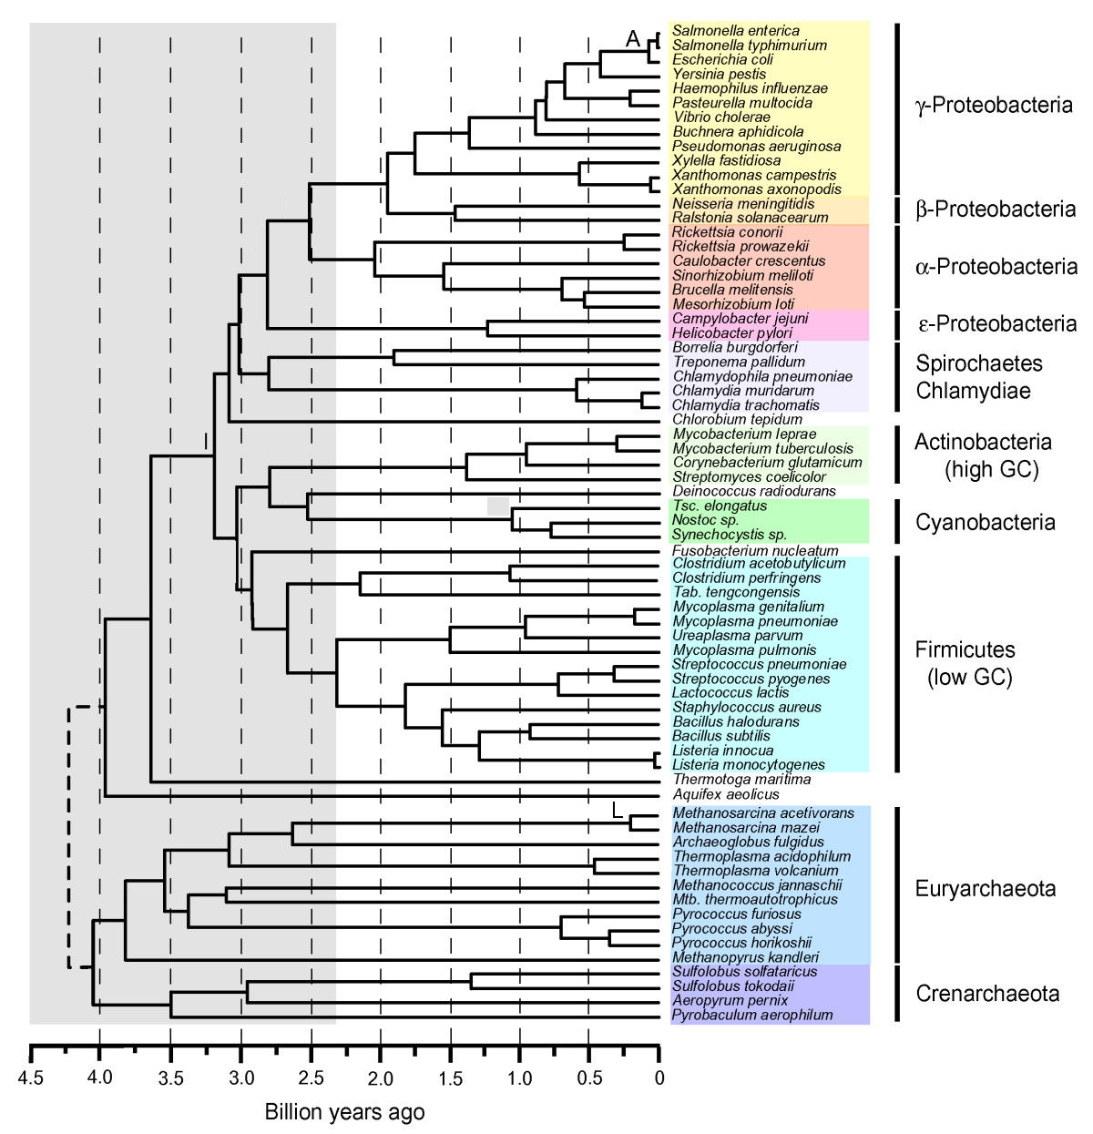
Evolutionary history of endosporulation
Endosporulation likely evolved once at the base of the Firmicutes
@2.6 billion years ago
Battistuzzi et al, 2004

Slide 4
Endosporulation is a complex trait
The process of sporulation involves approximately 10% of the genes in Bacillus subtilis.
The endospore provides not just a low energy state, but protection against harsh conditions
The growth advantage of endosporulation is related to variability of growth conditions.

Slide 5
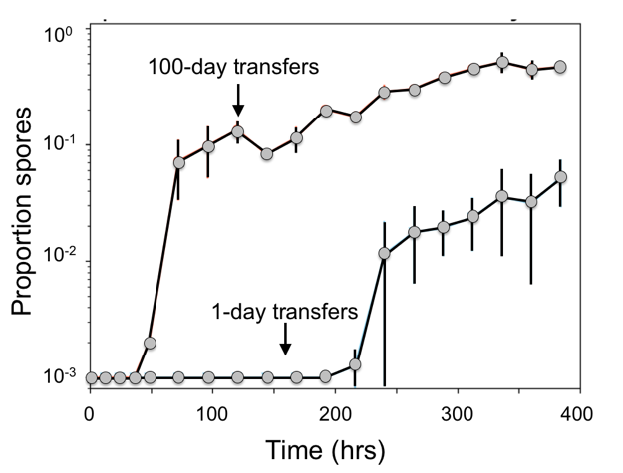
Fig. 4. Bacillus loses ability to make spores when evolved under a high energy (1-day transfer) vs. low energy (100-day transfer) transfer regime.
Phenotypic sporulation is lost quickly under laboratory conditions and others have shown that sporulation-specific genes accumulate missense/nonsense mutations.

Slide 6
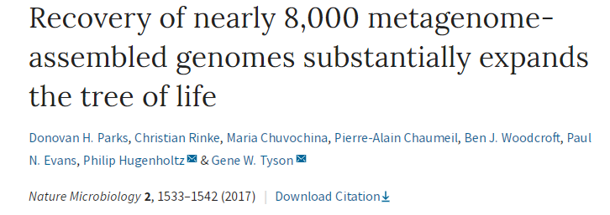
1296 new Firmicutes genomes available for our investigation.
The dataset includes a large percentage of genomes the diverge substantial from cultured representative.

Slide 7
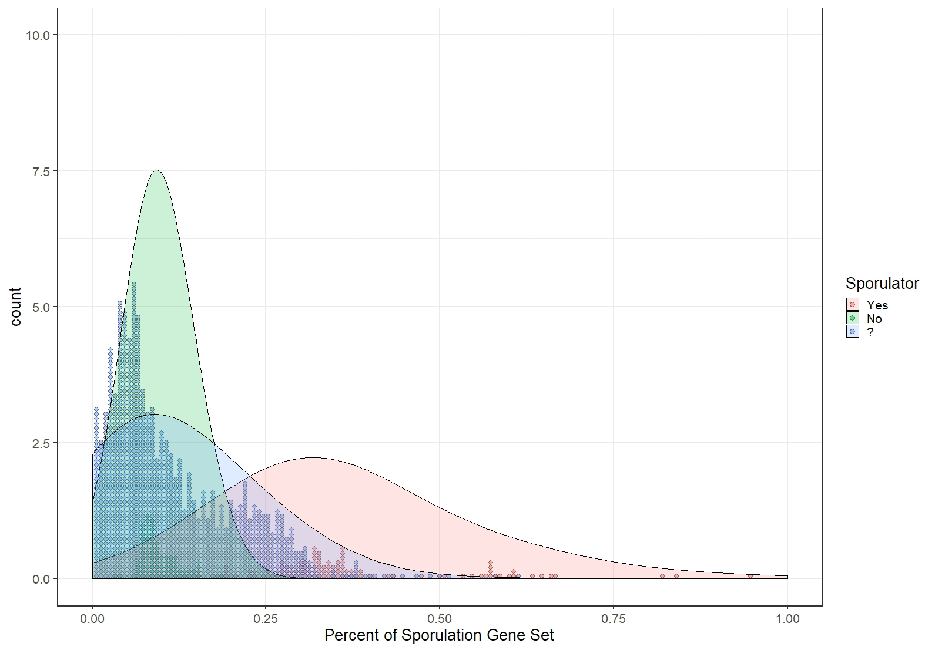

Slide 8
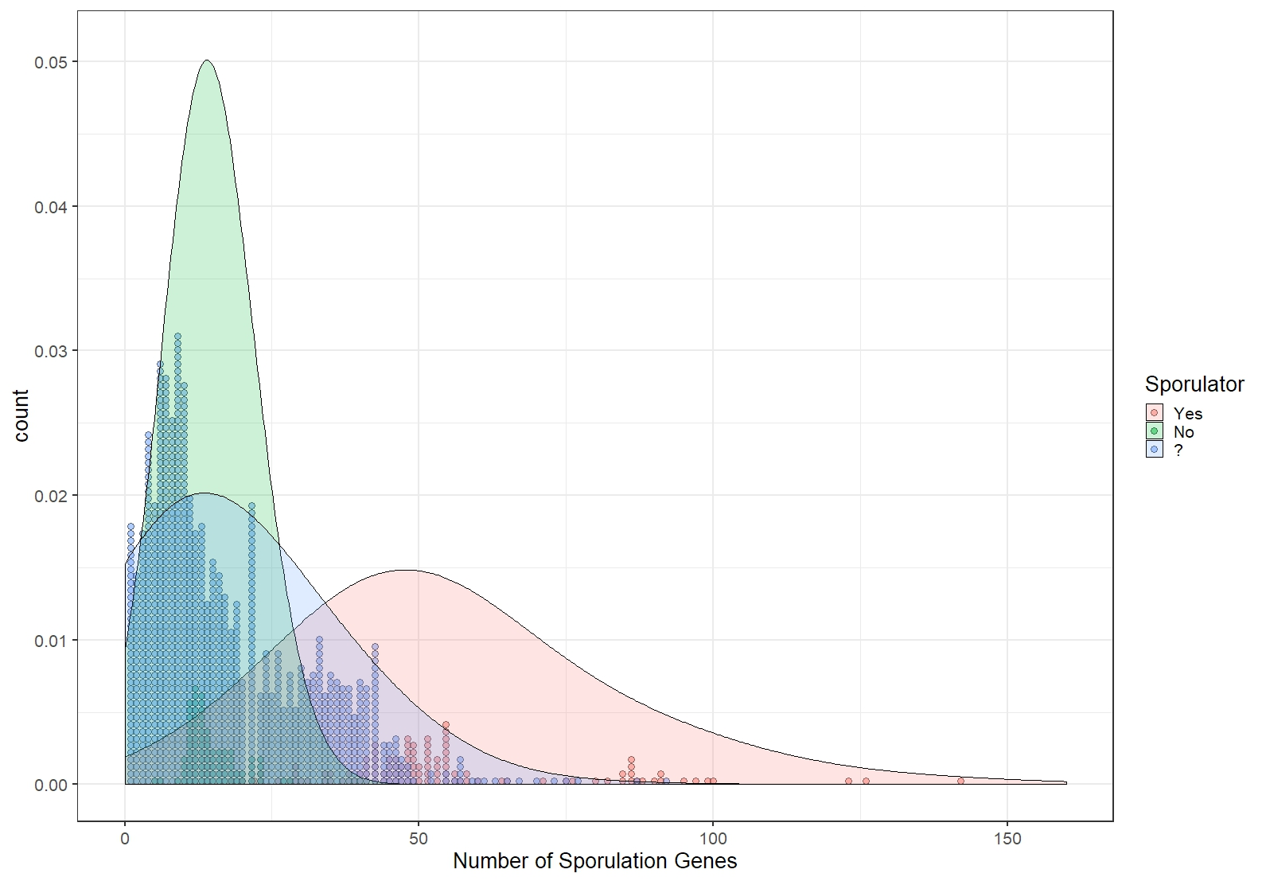

Slide 9
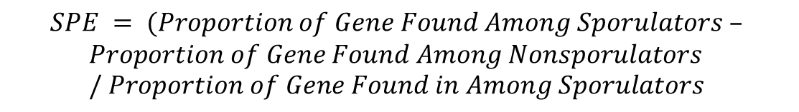
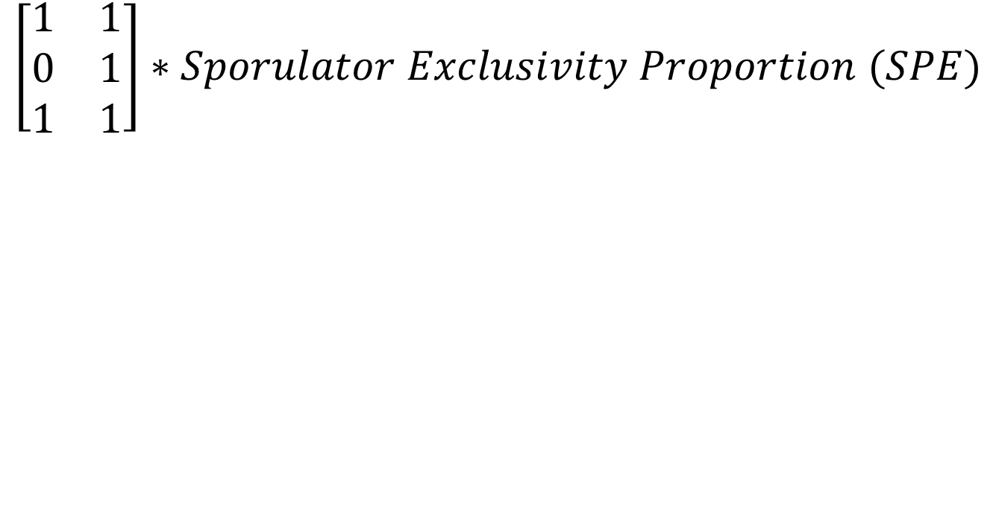
Weighted Percent
$$\left[\begin{matrix}1 & 1 \\ 0 & 1 \\ 1 & 1\end{matrix}\right]∗Sporulator Exclusivity Proportion (SPE)$$
$$SPE = (Proportion of Gene Found Among Sporulators –$$
$$Proportion of Gene Found Among Nonsporulators / Proportion of Gene Found in Among Sporulators$$

Slide 10
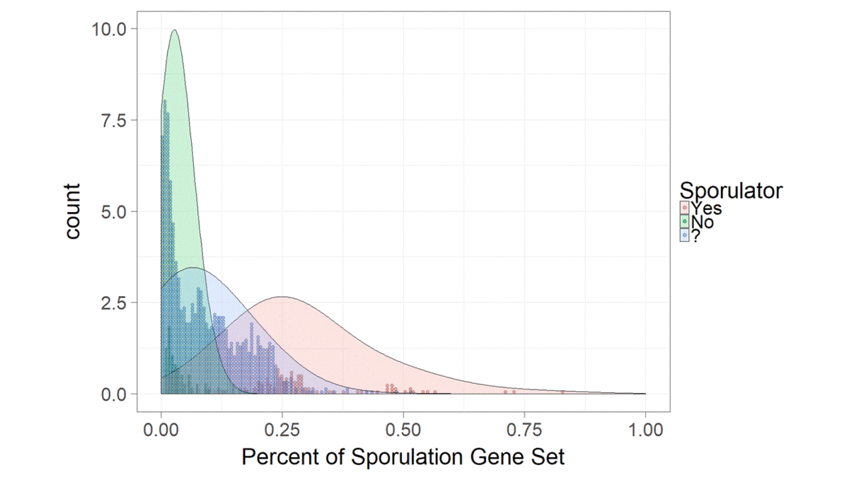

Slide 11
Mean No ≈ 14.5 genes

Slide 12
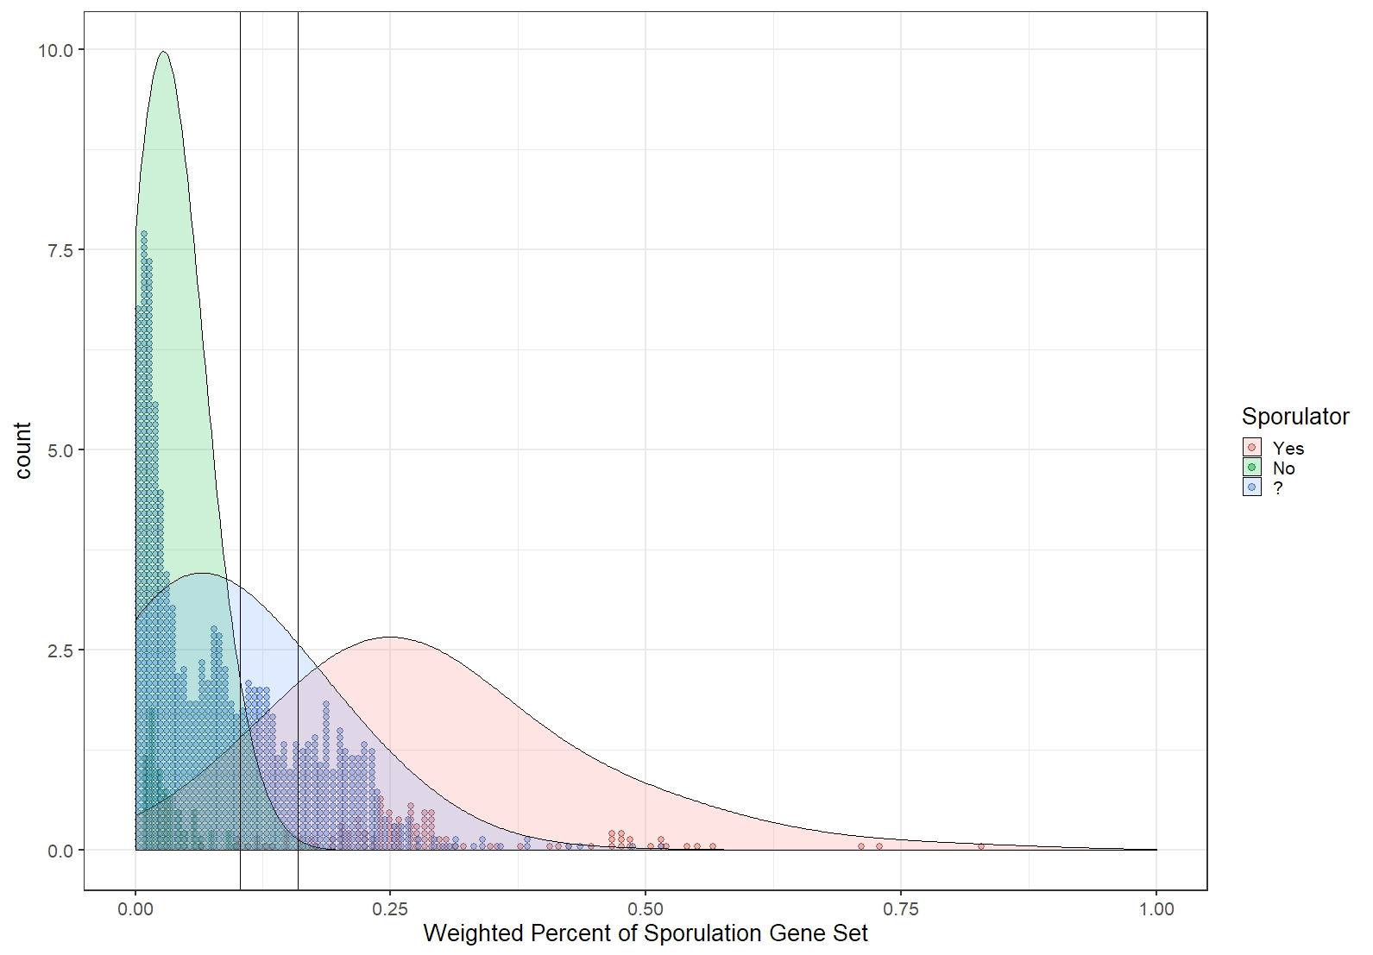
Mean No ≈ 4.75 “good” genes
Likely Sporulators
Sporulators
3.290σ No
1σ Yes

Slide 13
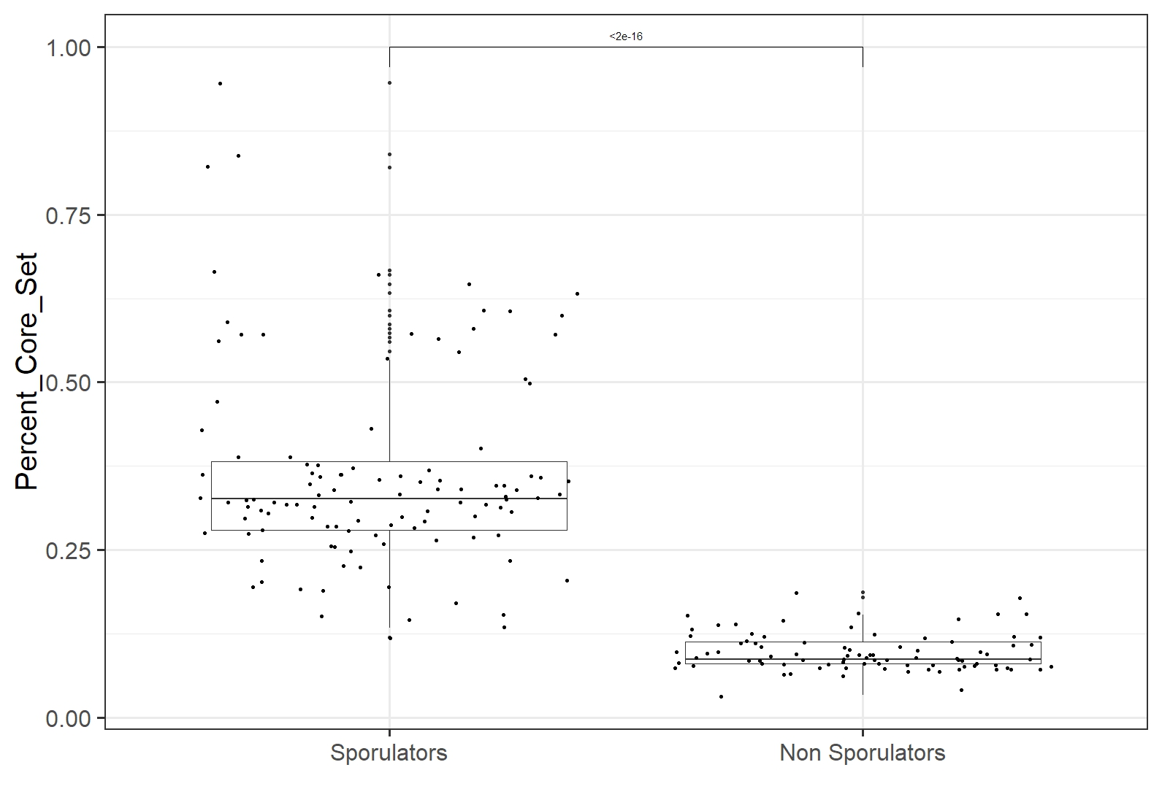

Slide 14
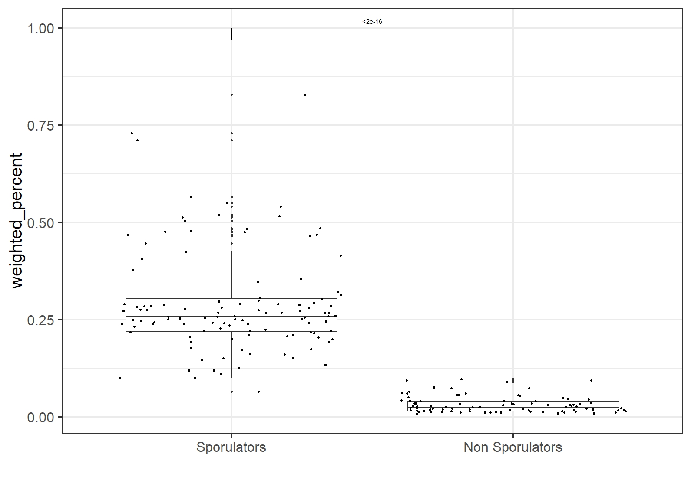

Slide 15
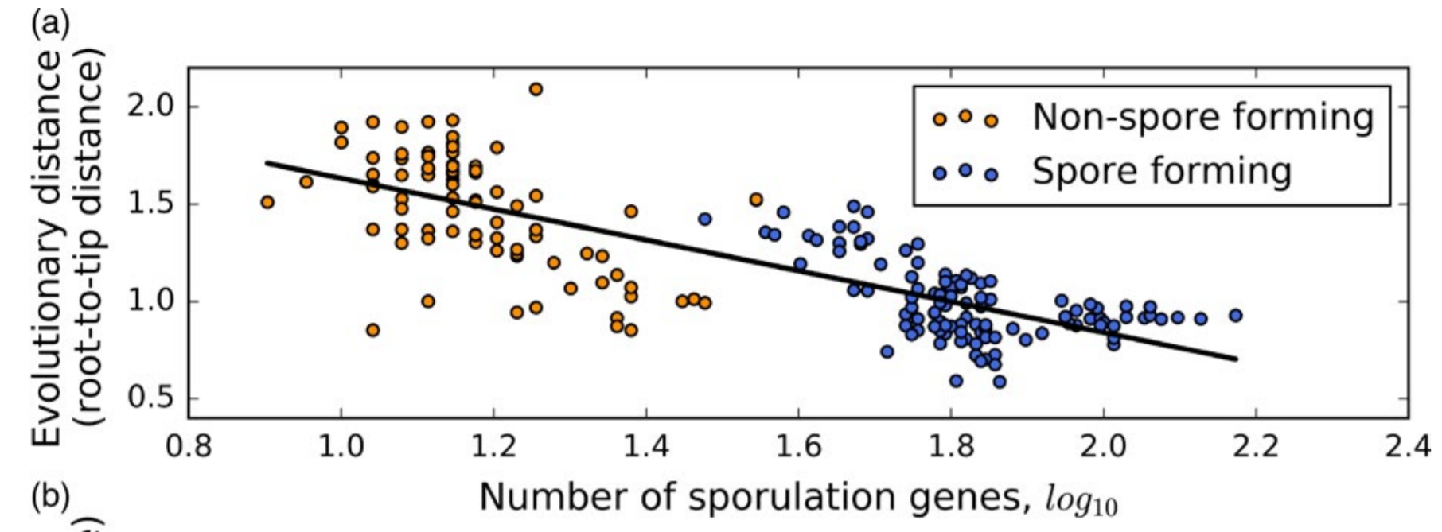
Relationship between Evolutionary Distance and Number of Sporulation Genes
Shoemaker and Lennon 2017

Slide 16
Does this model also fit data from meta genomes?
Previous analysis used trees and sporulation genes found in (Weller and Wu).
Here we expanded the sporulation and analysis and attempt to include metagenome derived from Parks et al, 2018.
Choose you use abbreviated ribosomal protein alignment list to improve speed of analysis and genome inclusion (L2, L3, L4, L5, L6, L14, L16, L18, L22, L24, S3, S8, S10, S17 and S19 (Hug et al, 2016))

Slide 17
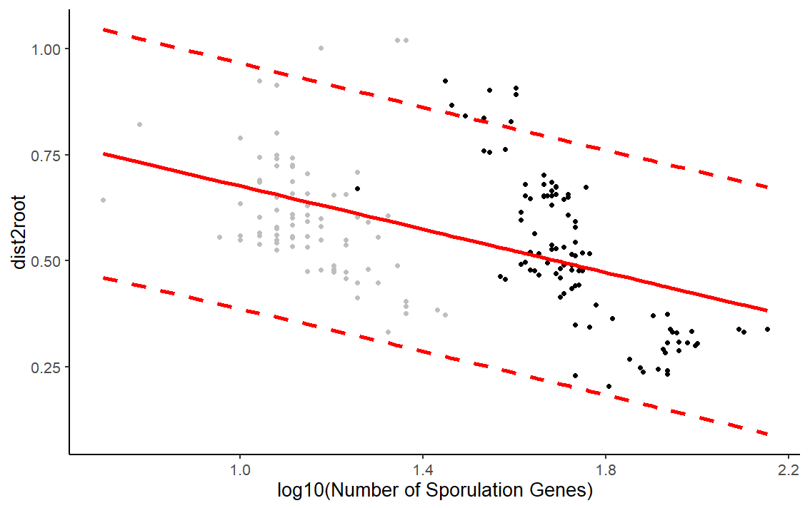
Reference
R² = 0.15

Slide 18
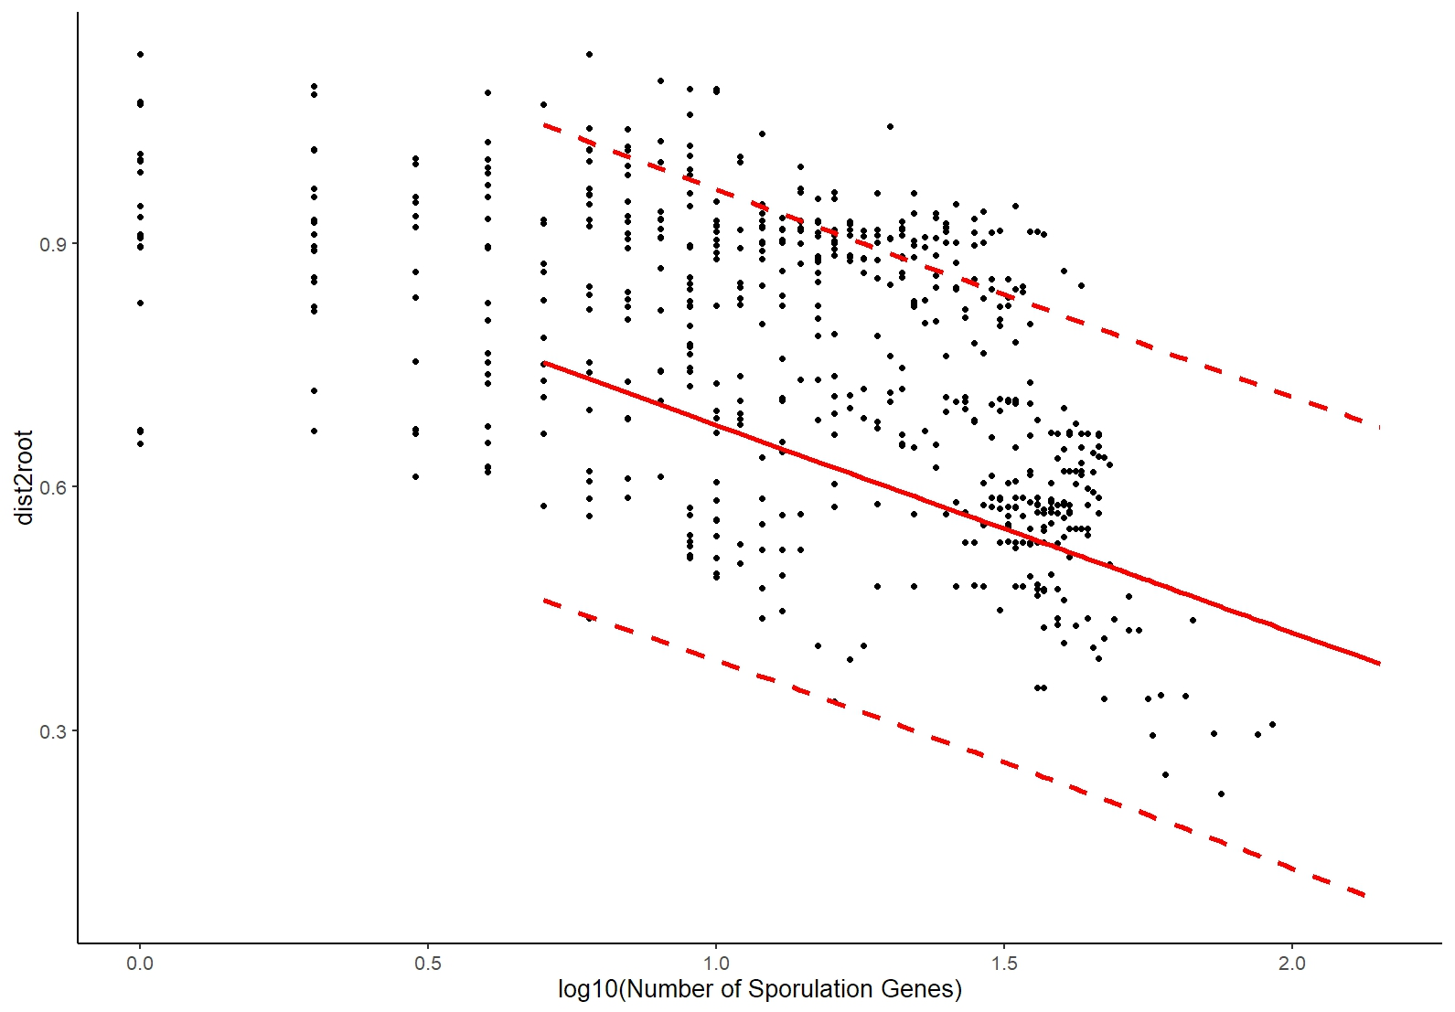
Parks et al

Slide 19
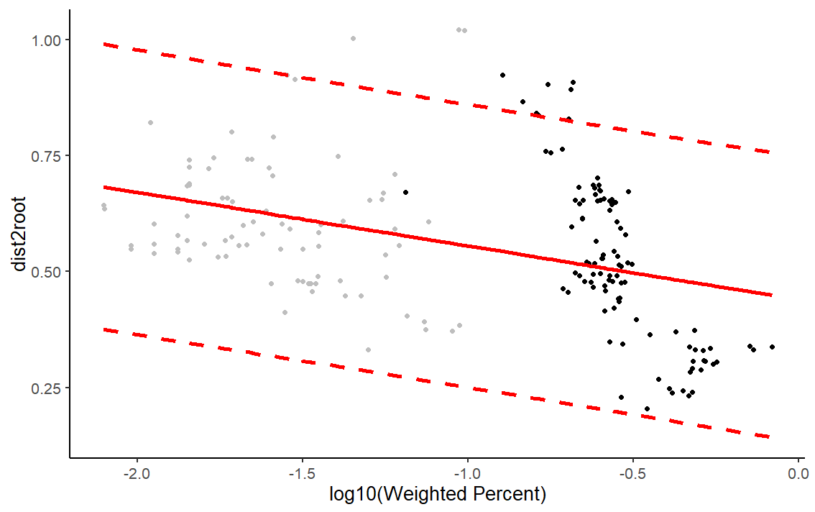
Reference

Slide 20
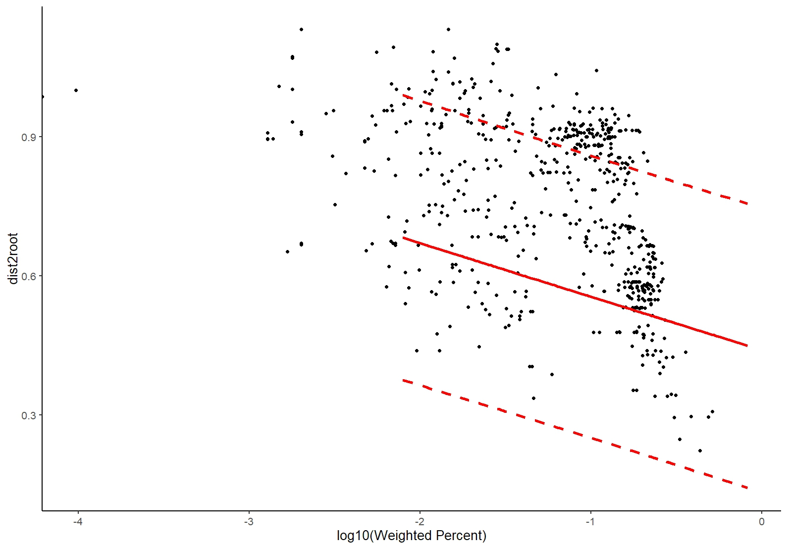
Parks et al

Slide 21
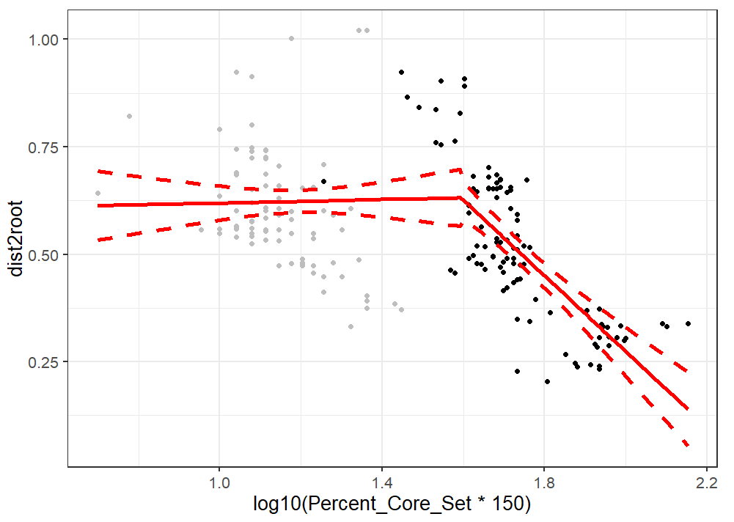
Reference
R² = 0.39
106 Gene BP

Slide 22
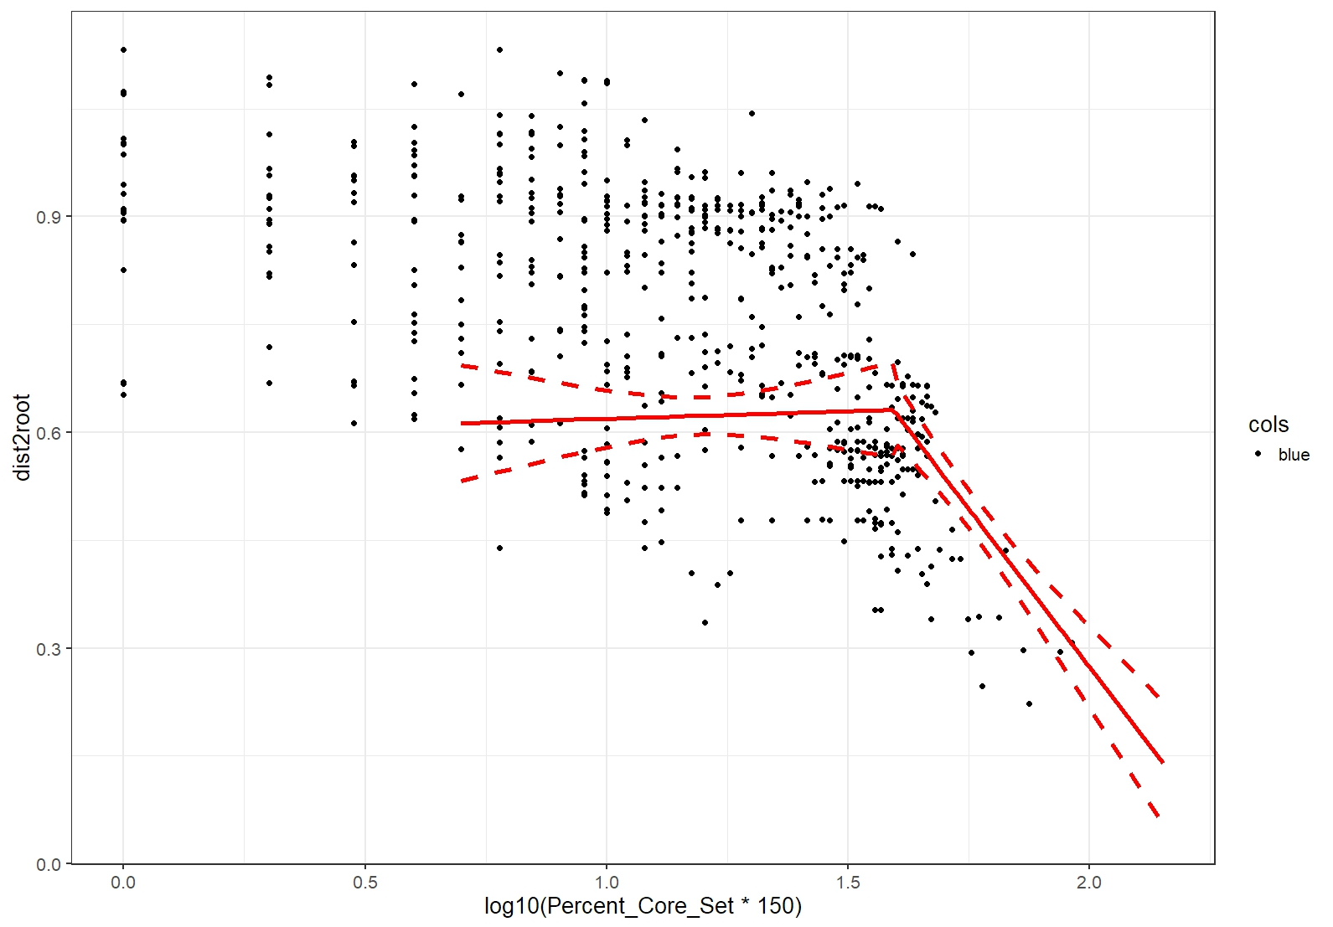
Reference

Slide 23
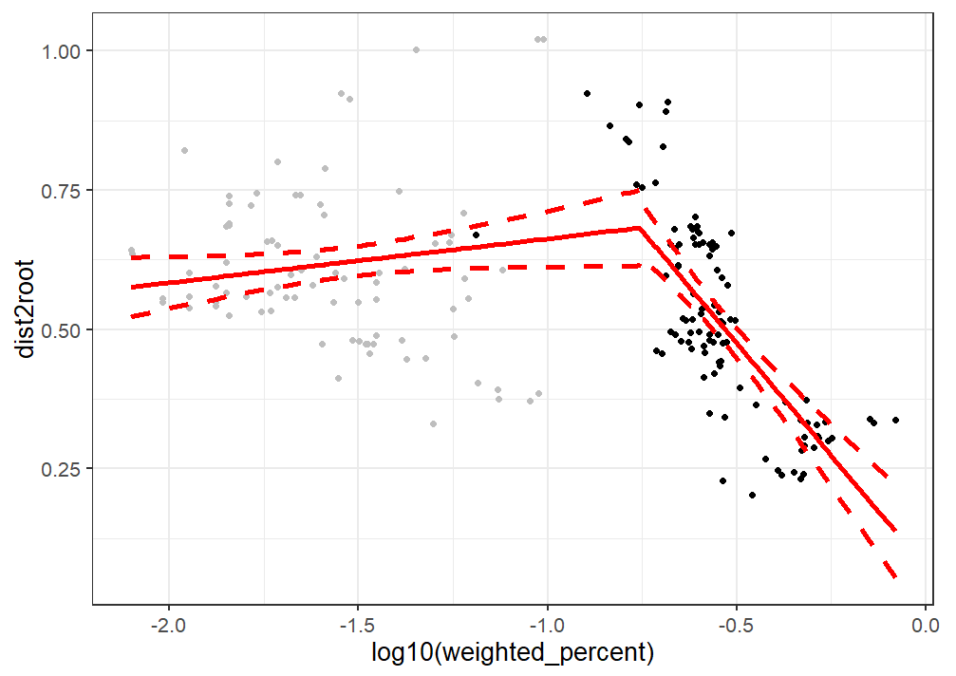
Reference
R² = 0.40
9.3 weighted gene BP

Slide 24
Mean No ≈ 4.75 “good” genes
Likely Sporulators
Sporulators
3.290σ No
1σ Yes

Slide 25
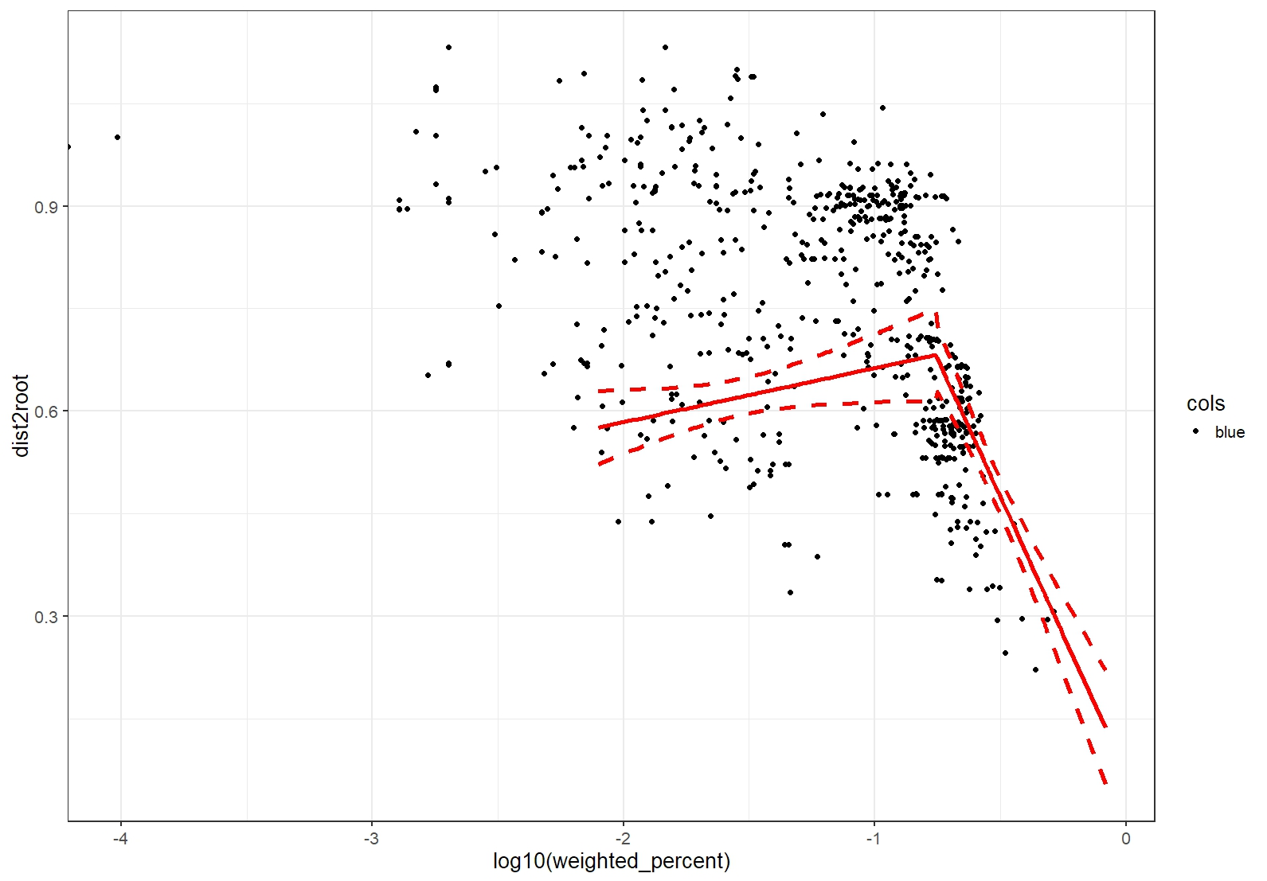
Parks et al

Slide 26
Segmented Regression Analysis
9.3 weighted gene < 15.4 gene cutoff for Likely Sporulators
Breakpoint was dramatically effected by weighting.
Models fit reference data better than lm(), tended to overestimate sporulation gene number in metagenome derived genomes.

Slide 27
Trait prediction and lm()
Given that sporulation derived evolutionary effects likely don’t apply to non-sporulators, applying a model only to a subset of the data may yield better results.

Slide 28
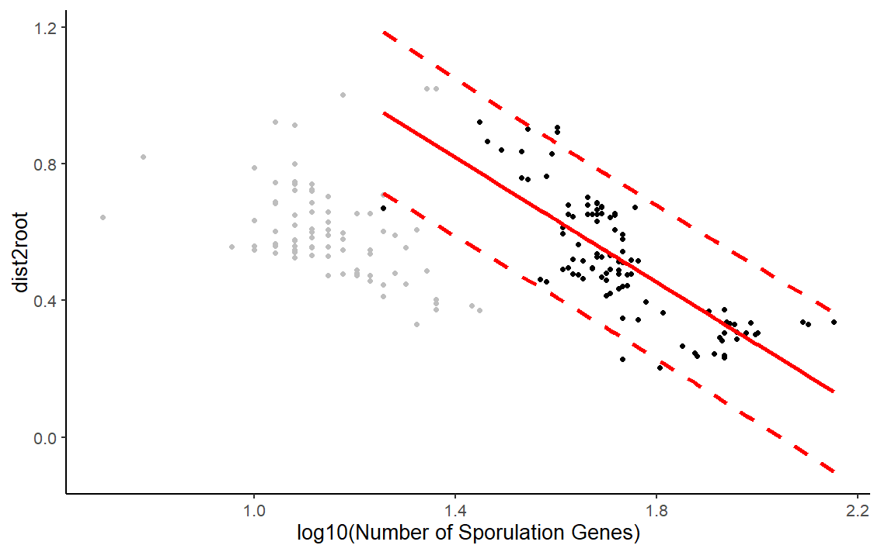
Reference
R² = 0.59*
*=only the sporulators

Slide 29
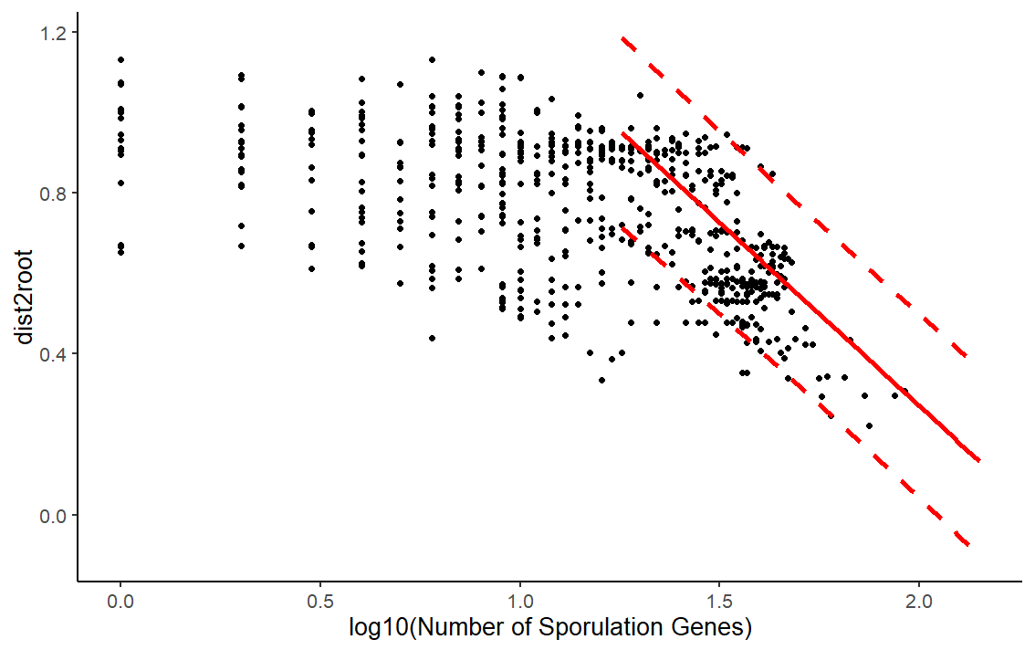
Parks et al

Slide 30
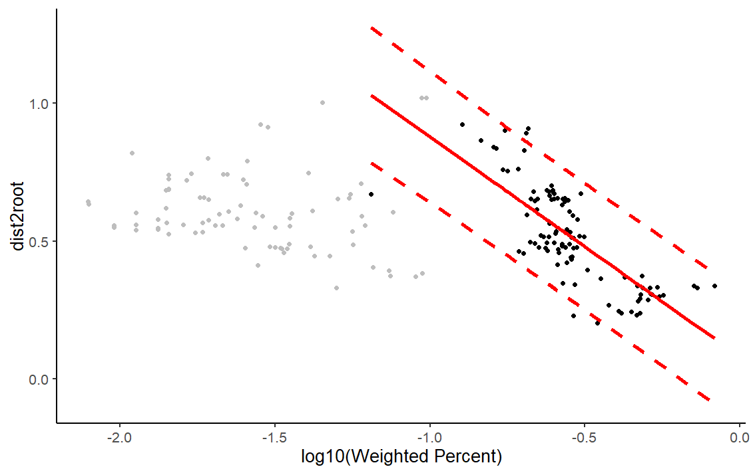
Reference
R² = 0.57*
*=only the sporulators

Slide 31
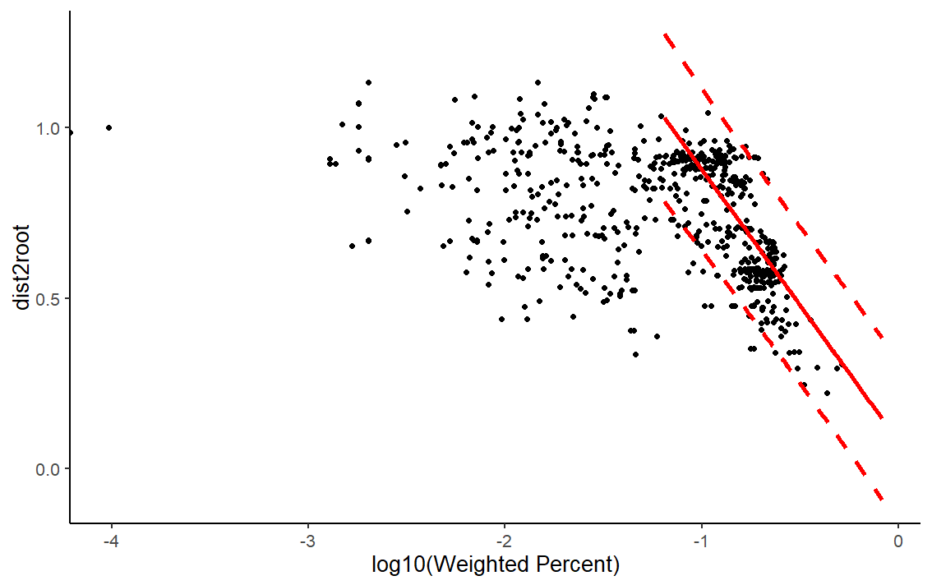
Parks et al

Slide 32
Does previous model fit new metagenomic data?
No
Implications include: Even more dramatic effects of sporulation complexity on evolutionary distance (i.e. ~3.5x sloop decrease)

Slide 33
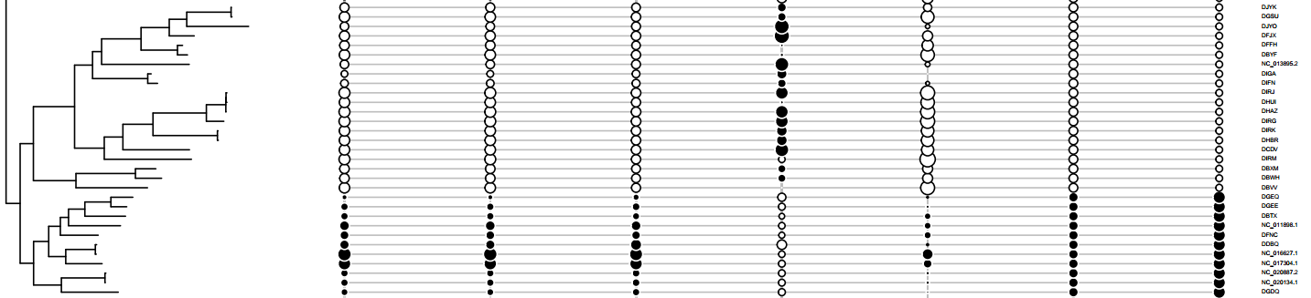
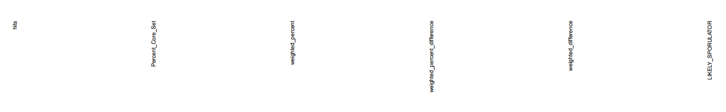
Phylogenetic Effects (Continued)
Hits %Spo w%Spo w%Spo_diff w_diff Lspo Spo

Slide 34
Are all sporulation gene equally important for predicting the phenotype?
Gene weighting improved separation of non-sporulators and sporulators.
Perhaps there is a subset of sporulation gene which are more predictive of the phenotype.
So probably not.

Slide 35
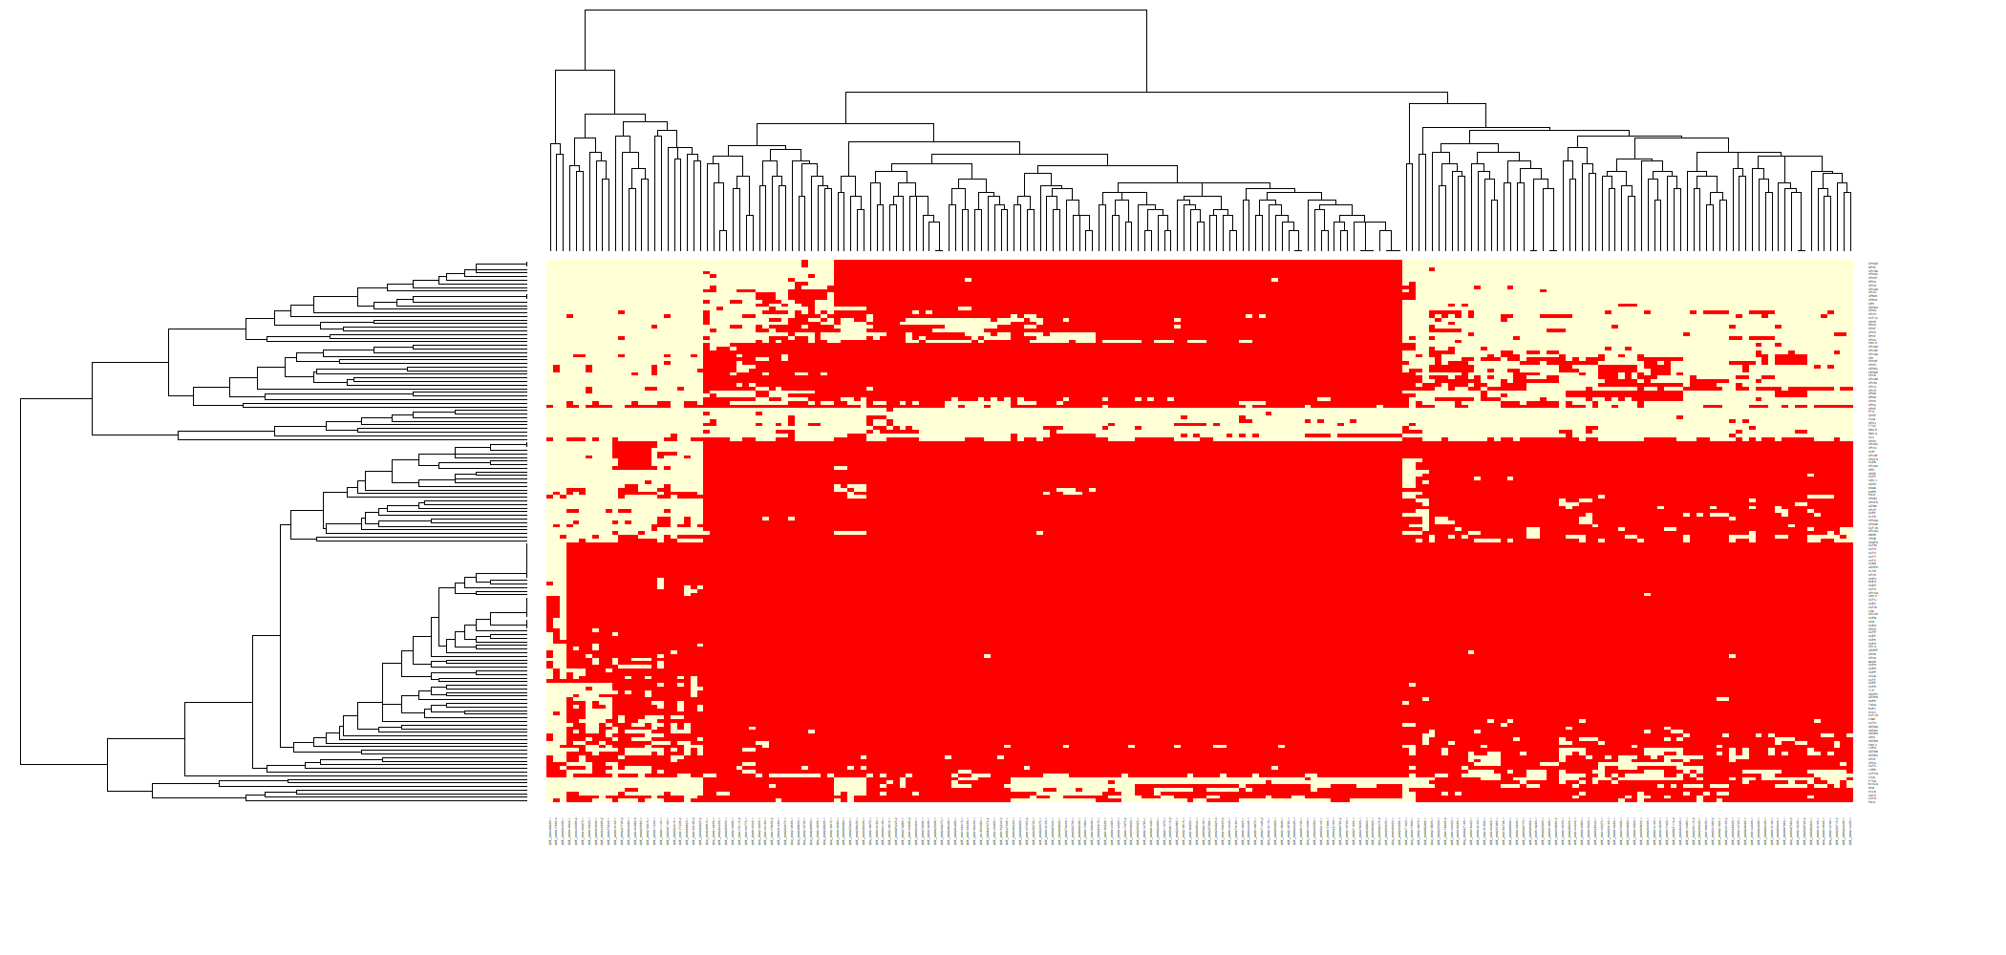
Gene by Genome Heatmap

Slide 36
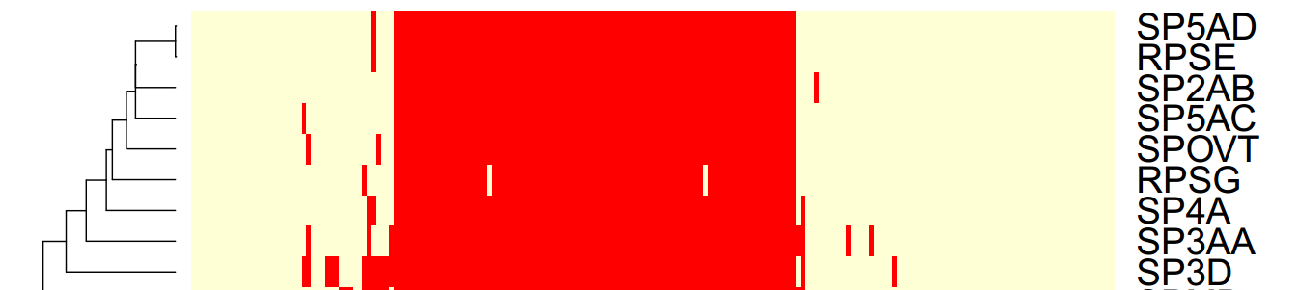

Slide 37
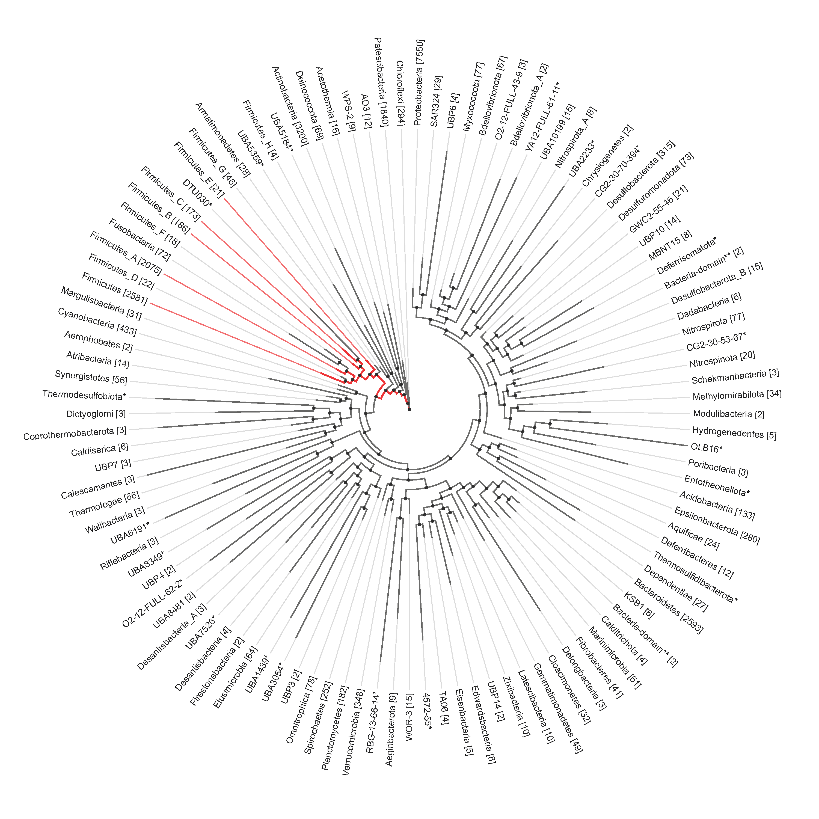
The prevalence of 9 “must inclusive sproulator genes” using KEGG annotations in AnnoTree

Slide 38
Several of the new phyla appear to have loss the ability to sporulate that was present in there ancestors.

